Slide 1
MGMT 6057 contemporary business management
Module 10: Managing human resources, union-management issues

Slide 2
Agenda
HRM: Definition and key activities
HR planning
Recruitment and selection
Training and development
Compensation and rewards
Performance feedback
Employee retention
Relevant legislation for workplaces

Slide 3
Agenda (cont’d)
Unions in Canada
Collective bargaining and collective agreements
Grievances, mediation and arbitration
Union and management tactics
Relevance for project managers and business owners

Slide 4

Human resource(s) management (HRM): definition & activities
HRM: all activities that an organization takes to attract, develop, and retain employees
HR activities should be integrated (consistent with each other)
HR activities should align with organizational objectives
HRM Activities Include:
HR planning
Recruitment & selection
Training & development
Discipline & termination
Retaining employees
Compensation & rewards
Performance feedback
Health & safety
Employee relations
Notes:
Image: https://www.serfe.com/media/k2/items/cache/e9f3064a37460e22935d3df9e26e53bb_XL.jpg

Slide 5
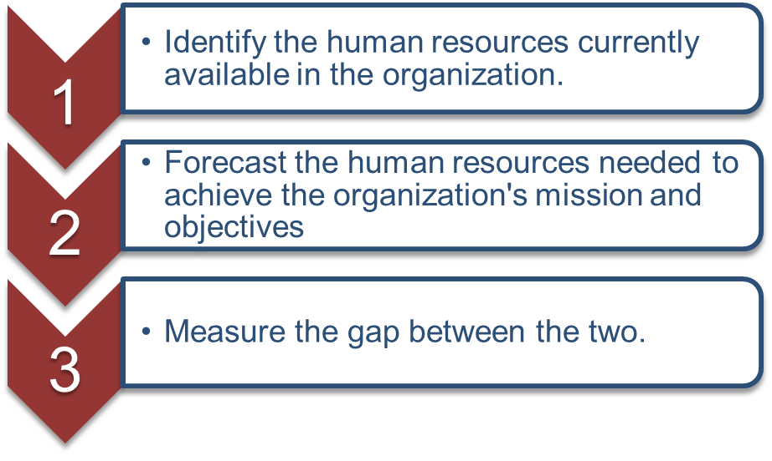
Human resources planning
Developing staffing plans based on strategies and needs, so that “the right number of people with the right skills are in the right place at the right time”
Job analysis
Job description: tasks and responsibilities of a job
Job specification: skills, education, experience required to do a job
Supply and demand forecasting
Expected turnover (losses)
Expected needs
Notes:
Figure CC BY 4.0. Retrieved from: https://commons.wikimedia.org/wiki/Category:Figures_from_Fundamentals_of_Business_by_Skripak

Slide 6

Recruitment & Selection
Recruitment: attracting potentially qualified candidates so they apply for available positions
Internal labour market: recruitment and selection from among existing employees
External labour market: recruitment and selection from applicants outside the organization
Selection: determining which applicant is preferable, making a job offer
Notes:
Image: https://www.gprs.uk.com/blog/uploads/Recruitment%20&%20Selection.jpg

Slide 7

Recruitment & Selection (cont’d)
Recruiting methods: word of mouth, employee referrals, company website, employment websites, social media, campus recruiting, co-ops/internships, ads, job fairs, ‘head hunters’, etc.
Selection methods: review applications, employment tests (e.g., drug, aptitude), interviews, physical exam, reference checks, etc.
Decide if selected candidate will be full time or contingent worker
Notes:
Image: https://www.bbalectures.com/ahad/wp-content/uploads/2018/04/Difference-between-Recruitment-and-Selection-2-e1524917510381.jpg
Organizations often use multiple recruiting methods and multiple selection methods

Slide 8

Training and development
New-employee orientation
Skills training
Mandatory training (e.g., WHMIS, AODA)
Leadership development
Job redesign
Job rotation
Job enlargement
Job enrichment
Notes:
Image: http://www.mywave.biz/images/icn-training-and-development.png
WHMIS: Workplace Hazardous Materials Information System
AODA: Accessibility for Ontarians With Disabilities Act

Slide 9

Compensation
Has an economic purpose
Payment in exchange for the use of a person’s time and efforts
Has a strategic purposes
A mechanism for attracting and retaining qualified workers
Notes:
Image: https://www.insperity.com/wp-content/uploads/2016/08/When-Compensation-is-the-Cure-to-Turnover-Skill-Gaps-and-Hiring-Holdups-1200x630.png

Slide 10

Components of Compensation
Direct Pay: wages, salaries
Performance-Based Pay: piecework, commissions, performance bonuses, profit-sharing, stock plans, etc.
Indirect Pay (“Benefits”):
Legally required benefits (e.g., employment insurance, Canada pension, etc)
Paid time off (e.g., vacation, sick leaves)
Insurance (e.g. health, life, disability)
Retirement benefits (e.g., pensions)
Notes:
Image: https://www.linkedin.com/media-proxy/ext?w=1200&h=675&hash=gtuMS3lMYDR7%2BrIVeEjeFncqXdY%3D&ora=1%2CaFBCTXdkRmpGL2lvQUFBPQ%2CxAVta5g-0R6plxVUzgUv5K_PrkC9q0RIUJDPBy-kUyKv89KfZX_ufM7YZLSiol4eeywBmAM6feasQzHhGo69LcLmY4Yx3A

Slide 11
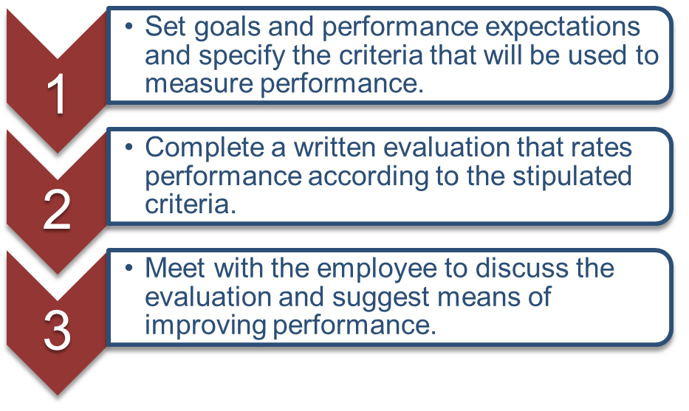
Performance feedback
Notes:
Photo CC BY 4.0. Retrieved from: https://commons.wikimedia.org/wiki/Category:Figures_from_Fundamentals_of_Business_by_Skripak

Slide 12

Performance feedback (cont’d)
Purposes:
pay/promotion determination
evidence to terminate
guidance for self-improvement or career development
communicates org’l objectives
Resistance:
no best method
some managers don’t want to be critical
raises conflict
time-consuming
evaluator bias
cultural sensitivities
Notes:
Image: https://kissflow.com/wp-content/uploads/2017/12/Employee-Feedback-Form.jpg

Slide 13
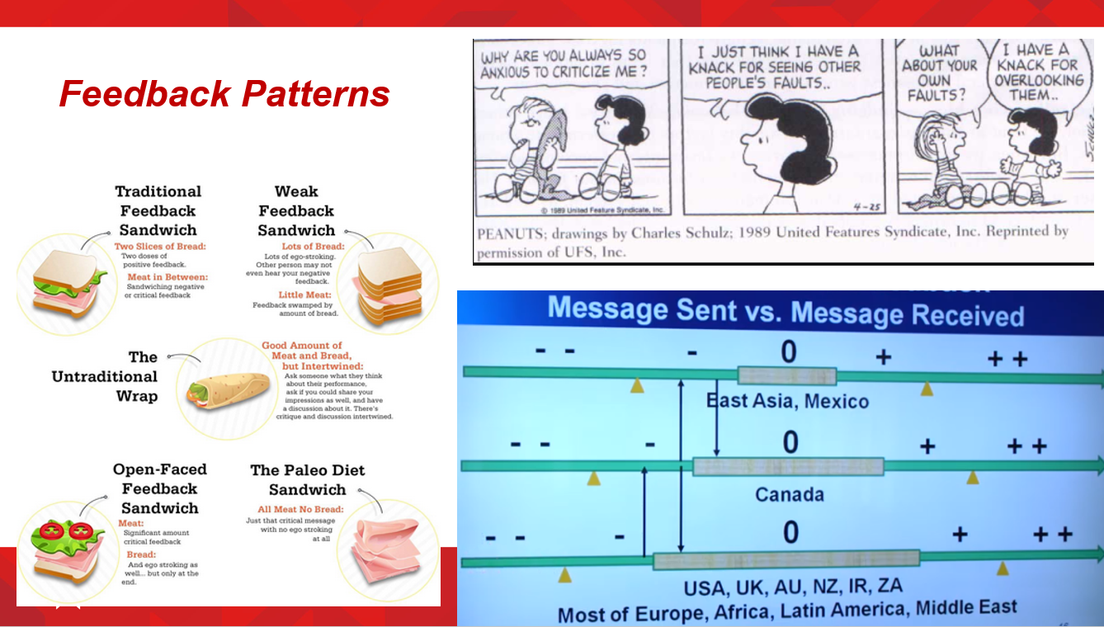

Slide 14

Employee retention
Excessive turnover:
may be demoralizing to remaining employees
may be expensive (costs to hire new workers)
may result in lower productivity due to new workers and vacancies
may affect the reputation of a firm (harder to find willing applicants)
Notes:
Image: http://www.insperity.com/wp-content/uploads/2015/12/4-reasons-for-high-employee-turnover-large01.png

Slide 15

Employee retention
Common (and avoidable) reason why employees quit is “bad bosses”
How to retain employees:
Creating a positive work environment
Employee-friendly workplaces
Recognizing employee contributions
Involving employees in decision making
Management/leadership training for managers
Alternative work arrangements (e.g., telecommuting)
Notes:
Image: modified from https://www.muypymes.com/wp-content/uploads/2015/01/mal_jefe.jpg

Slide 16

Examples of HR-Related legislation
Ontario Human Rights Code: protection against discrimination based on age, race, marital status, gender, sexual orientation, etc.
Employment Standards Act: regulations concerning payment of wages, hours of work, minimum wage, overtime, vacation, holidays, leaves, termination, severance pay, etc.
Occupational Health and Safety Act: duties of employers, health and safety committees, right to refuse unsafe work, workplace violence/ harassment
Notes:
Image: http://rismedia.com/wp-content/uploads/2016/07/legislation_concept_665x350.jpg

Slide 17
HR Legislation examples (cont’d)
Labour Relations Act: regulates employment relationships in unionized workplaces (known as labour relations or industrial relations)
Pay Equity Act: if 10+ employees, ensures that female-dominated job classes are not paid less for work of equal value to male-dominated job classes
Accessibility for Ontarians with Disabilities Act: accommodating needs of people with disabilities when it comes to hiring, providing workplace information, etc.
Notes:
Image: http://rismedia.com/wp-content/uploads/2016/07/legislation_concept_665x350.jpg

Slide 18


Unions in canada
Union: organized association representing workers, formed to protect their rights and interests by negotiating working arrangements with employers
Union structure: locals (shop stewards, union presidents), provincial/ national unions (made up of locals), labour federations (made up of unions)
Unionization has been declining in Canada
26% of employees in Ontario are covered by a union collective agreement
Notes:
Source: union density in Ontario: https://www.statista.com/statistics/442980/canada-union-coverage-rate-by-province/

Slide 19



Unions in Canada (cont’d)
Provincial government policy may be more/less supportive of unions, depending on party in power
Public support of unions is mixed
Depends on the bargaining issue
Depends on the extent to which public is inconvenienced by labour strikes
Many employers voluntarily increase compensation and improve working conditions to pre-empt the formation of a union in their workplace

Slide 20

Unions in Canada (cont’d)
Union activism has led to laws beneficial to overall society: child labour, overtime, minimum wage, workplace safety, pay equity, etc.
Workplace unions can prevent unfair or abusive practices by employers
BUT…
Unions constrain mgmt decision-making, compensation costs of unionized workers are higher, relationship may be adversarial
Notes:
Image: https://www.acpcomputer.edu.sg/wp-content/uploads/2013/08/banner.jpg

Slide 21

collective bargaining & agreements
Collective bargaining: Negotiating to establish a collective bargaining agreement (CBA)
CBA: a contract covering a specific time period (typically 1 to 5 years)
Common CBA provisions:
Job classifications
Wages, benefits
Transfers and promotions
Working conditions, health and safety
Job security, technology changes
Grievance procedures
Management rights
Notes:
Image: https://image.slidesharecdn.com/cb-140428220712-phpapp02/95/collective-bargaining-13-638.jpg?cb=1398722901

Slide 22

Grievances, mediation, arbitration
Grievances: formal complaints that the bargaining process has been corrupted, or a provision of the CBA has been violated
Mediation: professional facilitator guides discussion between union and management representatives when negotiating a new CBA or resolving grievances
Arbitration: binding decision from neutral adjudicator(s) if mediation fails
Notes:
Image: http://joannaleefer.com/wp-content/uploads/2016/02/Mediation.jpg

Slide 23


Union and management tactics
To win public support and compel the other side to agree to its demands
Union Tactics:
Picket
Strike (may be legal or illegal)
Boycott
Management Tactics:
Lockout
Replacement workers
Notes:
Image: https://skift.com/wp-content/uploads/2018/10/MarriottStrikeWorkersUniteHere.jpg
http://cs.mg.co.za/crop/content/images/2013/09/26/employerlockoutsi2e.jpg/800x450/
Legal strike: when collective agreement expires and negotiations aren’t progressing well
Illegal strike (aka wildcat strike): workers walk away from their jobs temporarily in protest, while collective agreement is still in effect

Slide 24
Relevance for project managers & business owners
For project managers:
Project managers undertake many HR activities within their project teams, such as:
Planning the number/ roles/ schedules of project team members, selection, coaching, performance feedback, discipline, etc.
For business owners:
If you have employees, YOU must undertake all HR activities - or else hire someone to be a HR Manager
Unions constrain management decision-making and can increase labour costs, but they are legally protected Canada

